Slide 1

WEATHER DATA , MUSIC & MOVIE powered by ITUNE API/OPENWEATHER.ORG

Slide 2
Elevator Pitch
We provide user with essential and entertaining information in their daily life.
Users are informed of current time and weather information.
User has the choice to select how many results they want for music and movie suggestions.
User will receive number of selected results, and can click on the image of the music/movie to play a video clip of music/movie selected.

Slide 3
Concept
DESCRIPTION:
User searches weather based off city and is given music and movie suggestions to match the mood of current weather result.
MOTIVATION :
discover new music and movie to enhance users feeling.
USERSTORY :
As a user, I want to receive current weather information for the city I search, based off that result, I would like to receive music and movie recommendations that matches the mood for the current weather.

Slide 4
Technologies to use :
API:
Music/Movie:
https://affiliate.itunes.apple.com/resources/documentation/itunes-store-web-service-search-api/
Open weather :
https://openweathermap.org/api
CSS Framework:
Foundation
https://get.foundation/
Color:
https://material.io/resources/color/
https://cssgradient.io/
Fonts:
https://fonts.google.com/

Slide 5
Tasks & roles:
Front end developer:
Michael Rosa-Vourazeris
Kristina al-ashqar
Back end developer:
Olivia, Youngmee, Park
Paul Nuguyen
Our Challenges & Success:
GitHub:
Cors error in Git hub deployed link, Github access.
(resolution: from Handle Cors Client Side https://gist.github.com/jesperorb/6ca596217c8dfba237744966c2b5ab1e)
Front end part :
get familiar with using new frame work , responsive layout.
Back end part :
Combine array into one master array (resolution- await ajax with async function)
Responsive embed layout – make disable or video function properly ..
Separate music and movie data into DOM (resolution- create 2 separate array as global variable and push music and movie data separately )
Success:
As a team we were able to overcome issues related to the functionality and layout of the code, to produce a fun and informative app for the user.

Slide 6
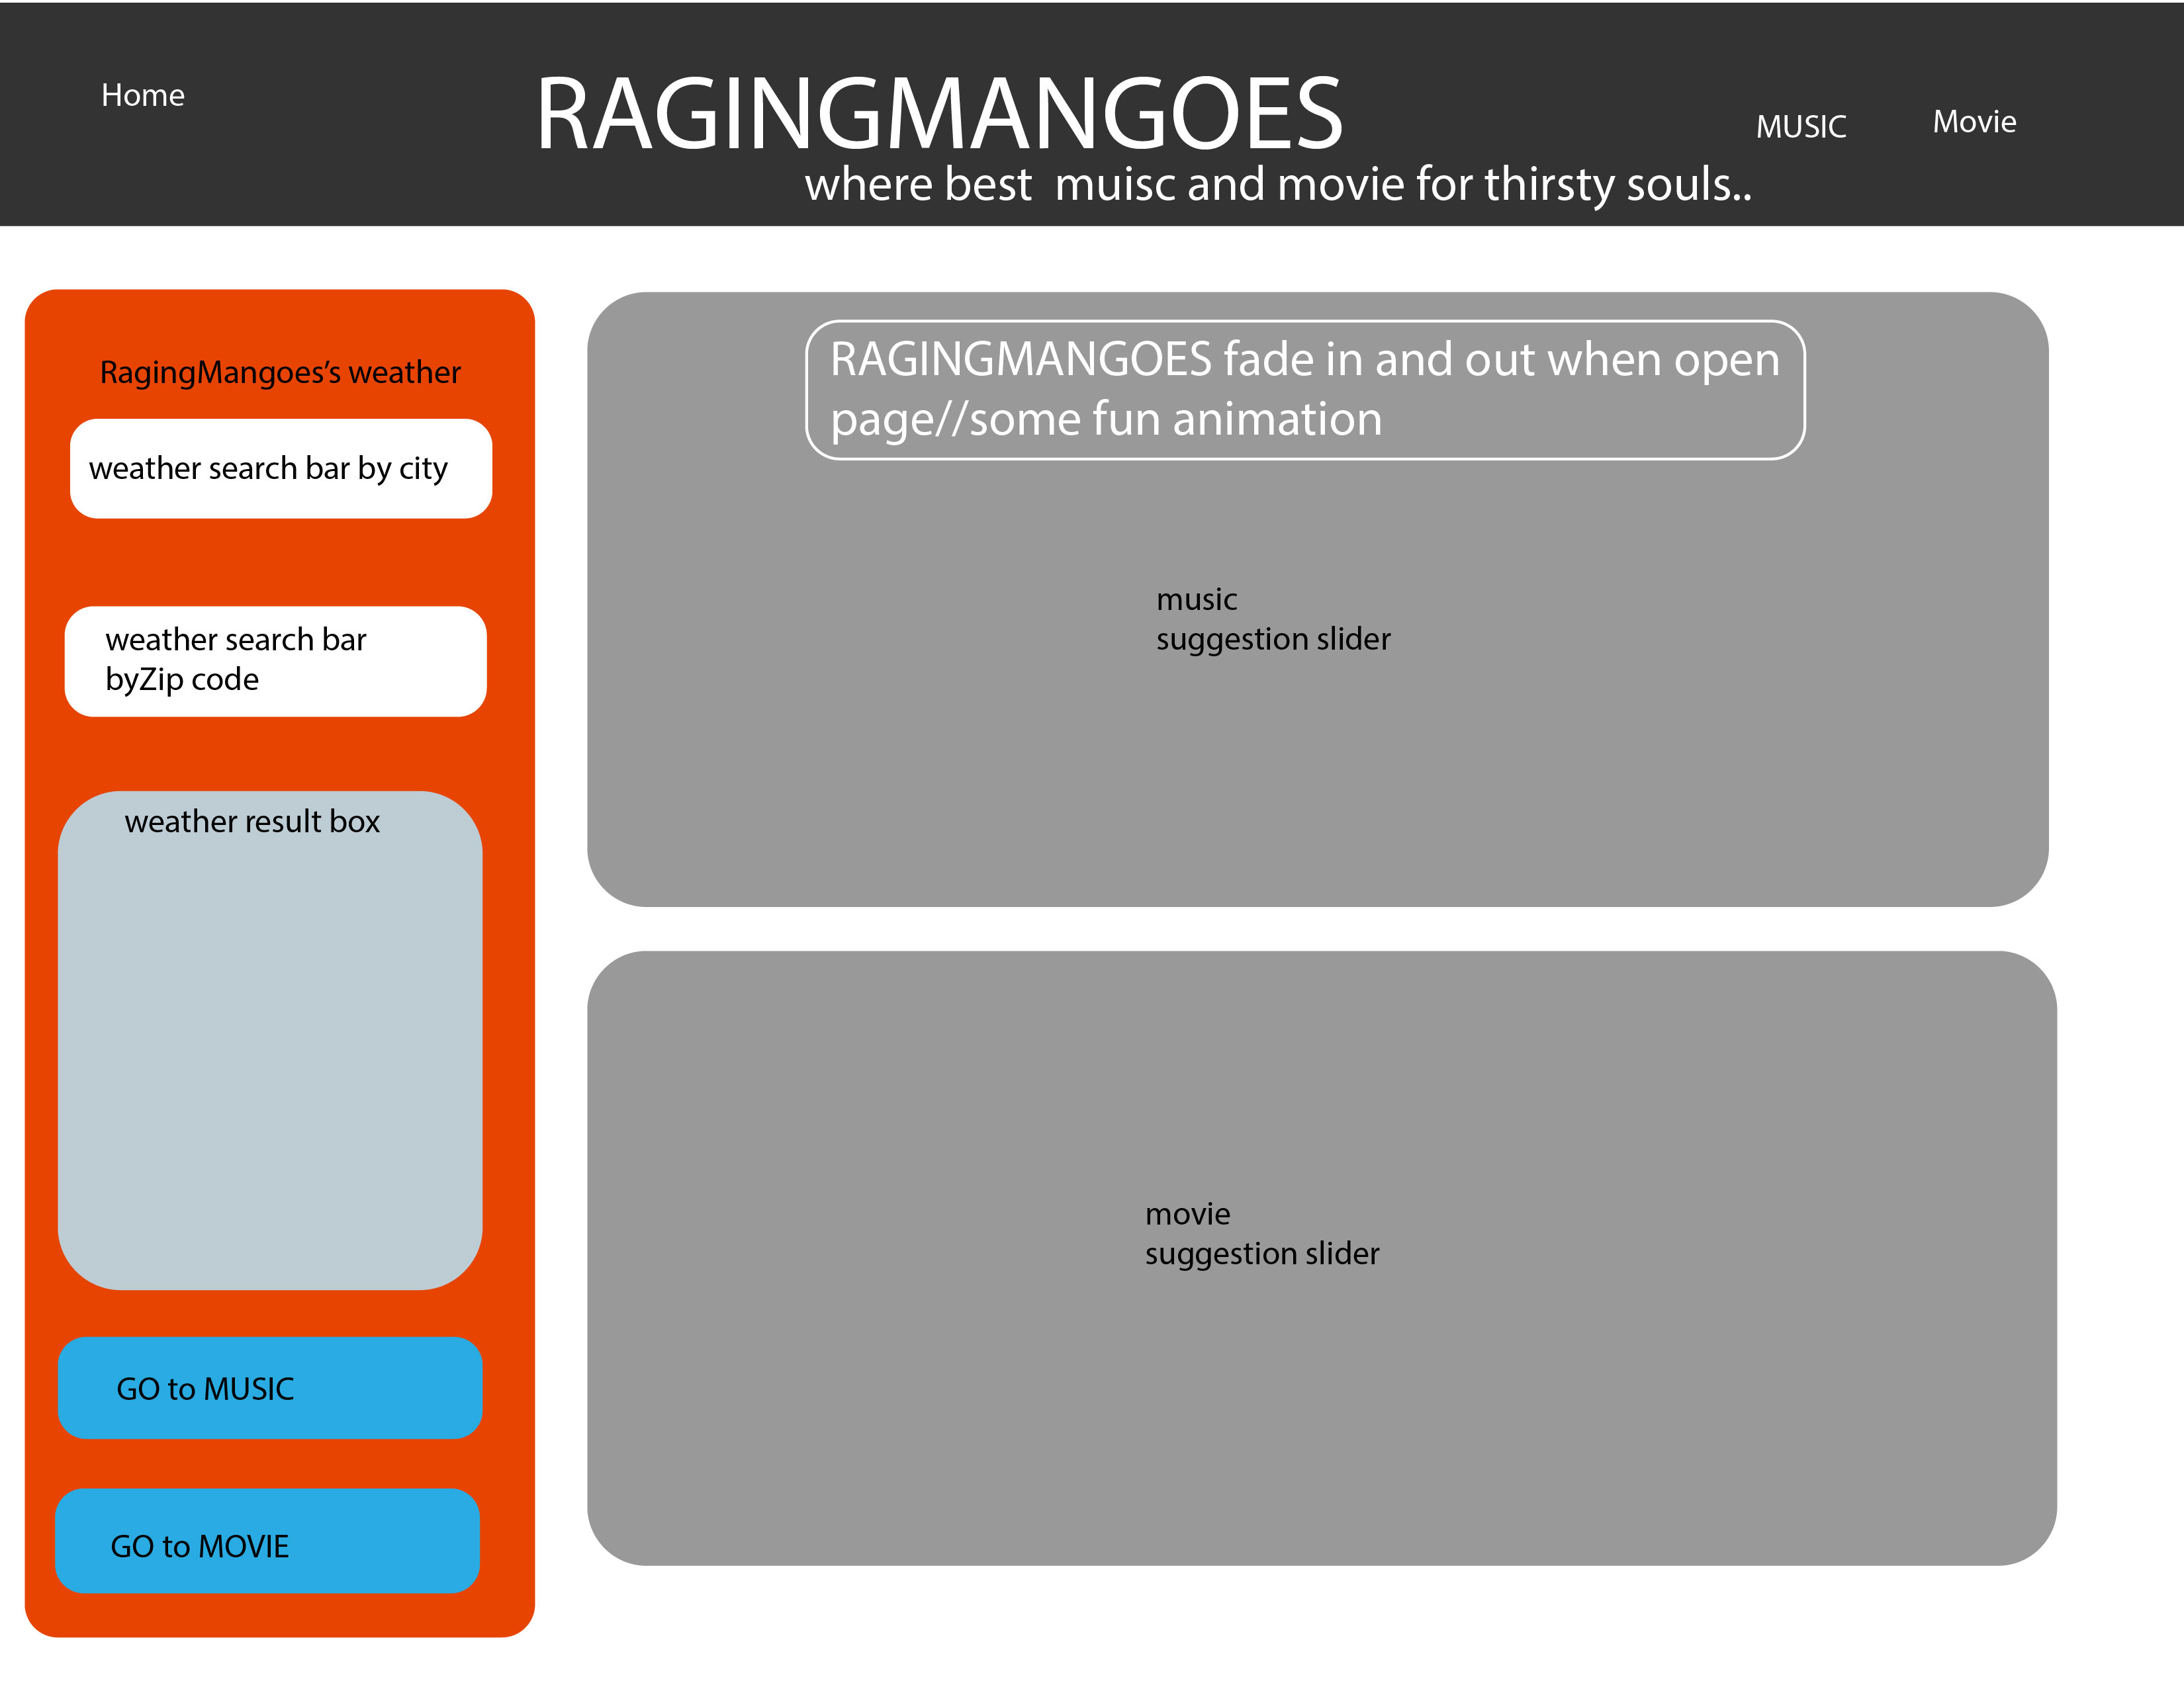
Original layout:

Slide 7
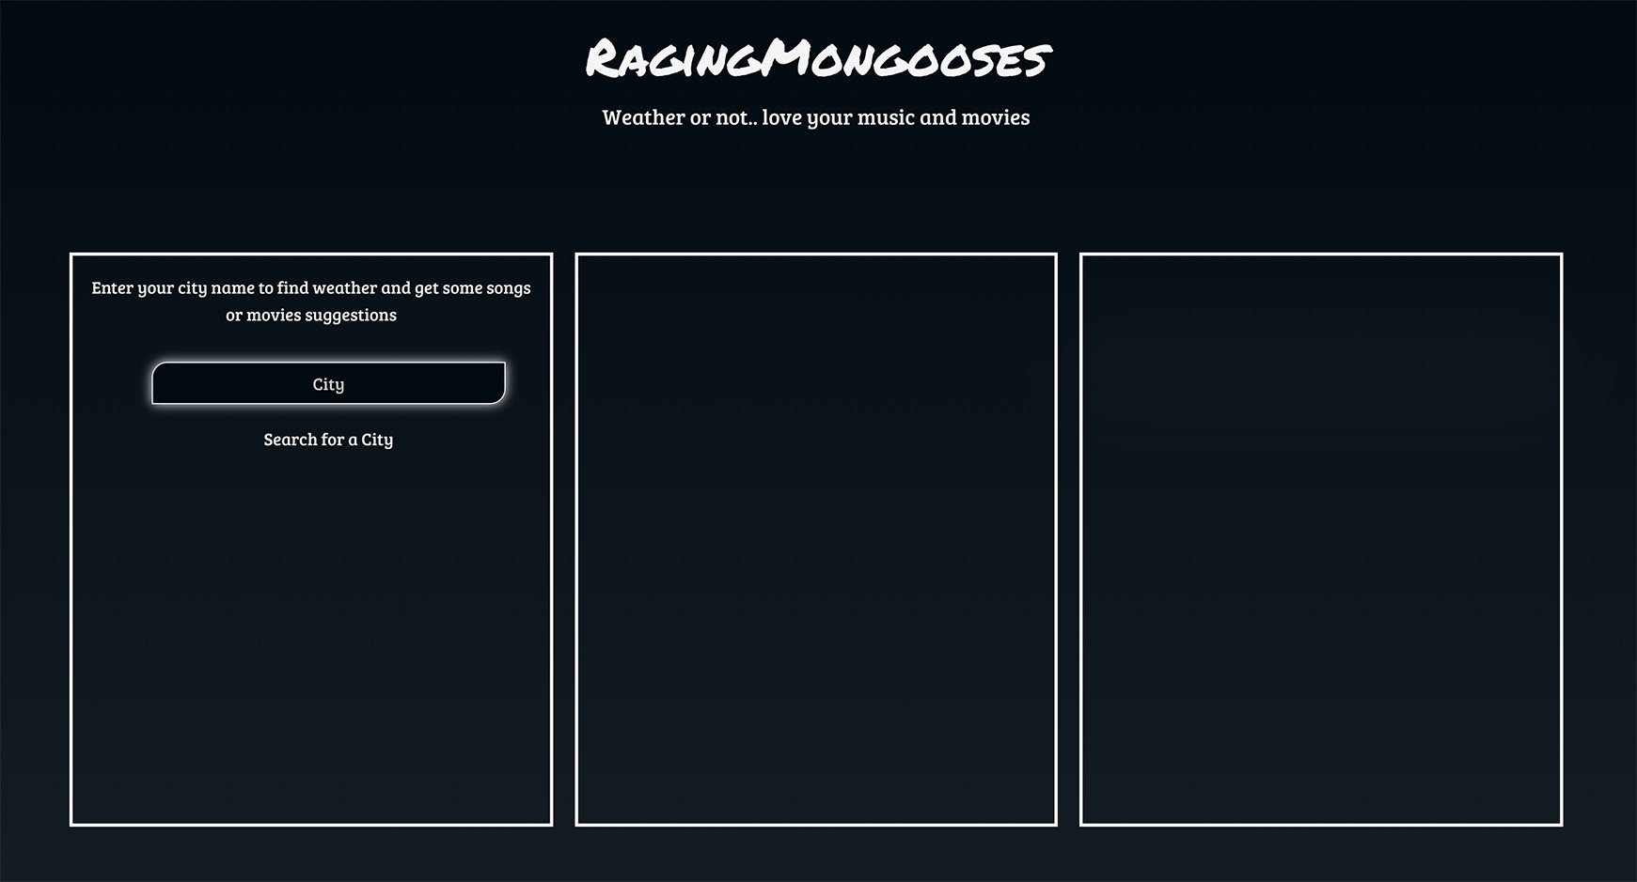
Actual APP view :
Layout
When user arrives on website,
the user can enter a city name
in the input area
Weather & selection
section
Movie/Music section
Video section

Slide 8
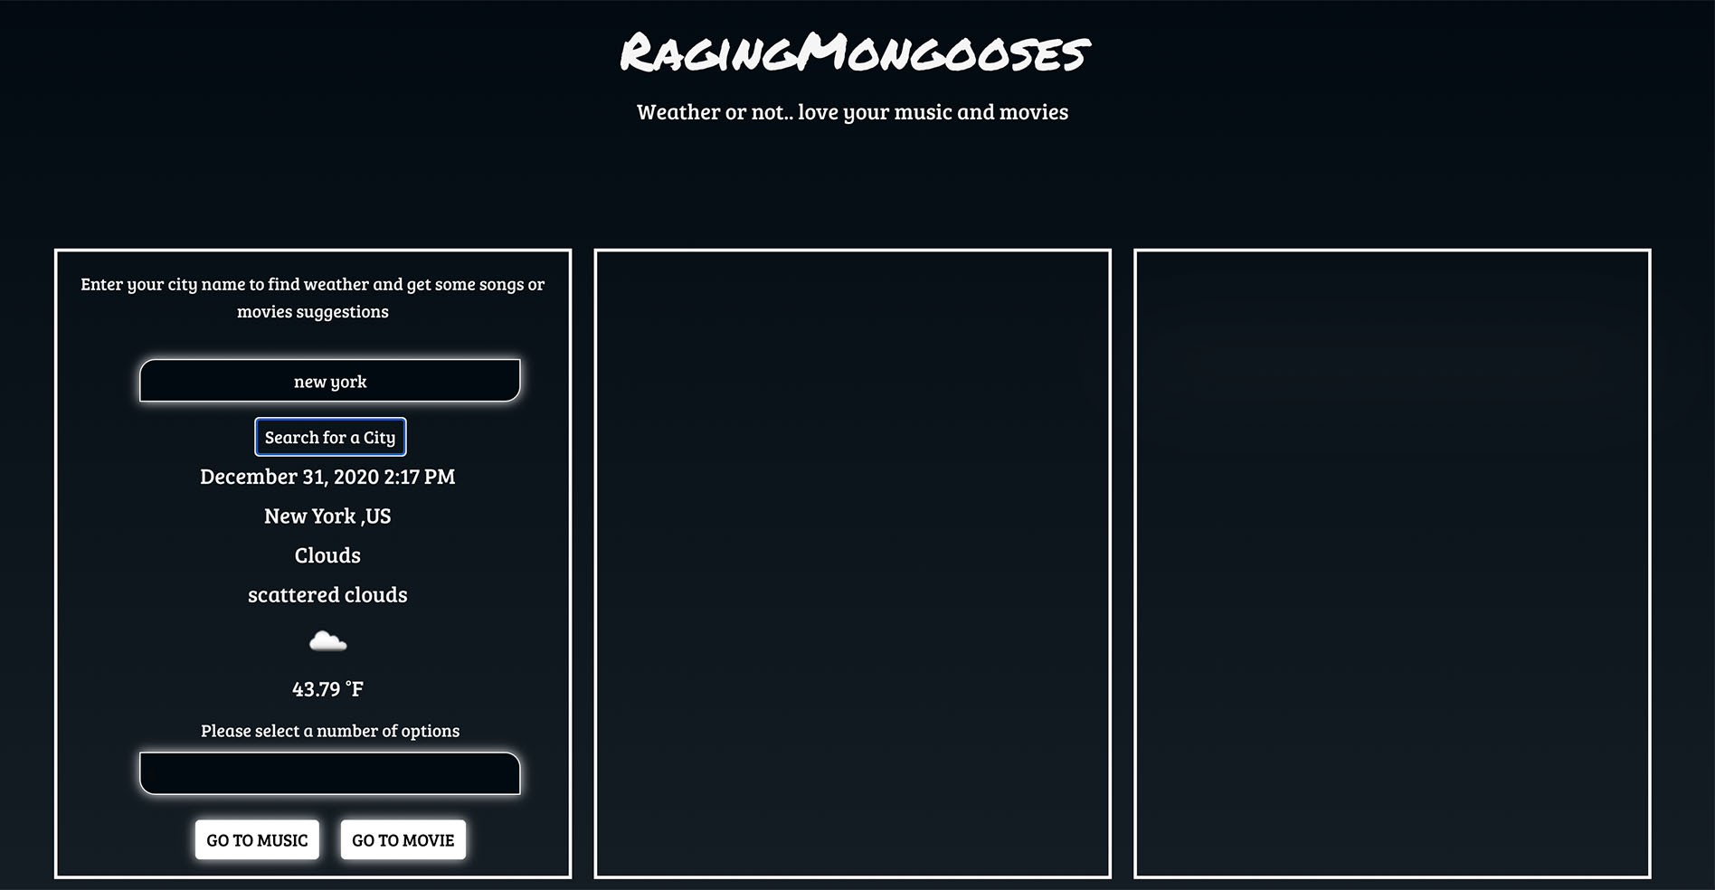
Actual APP view :
2. Weather info
/selection
Then the user will receive the current weather data for said city,
and be given an option to select the number of
music or movie results they would like to receive to match the mood of the current weather.
User’s
Current time
Weather data
User’s
Number of selection
As dropdown menu

Slide 9
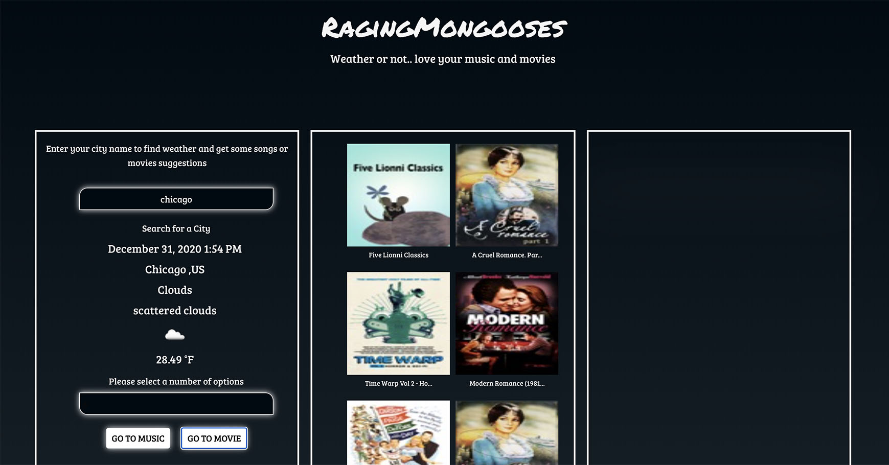
Actual APP view :
3. Visual info
Then receive
recommended data
per number of selection.
User’s
Choice of
Music /Movie
Visualized section
where user select before view
video

Slide 10
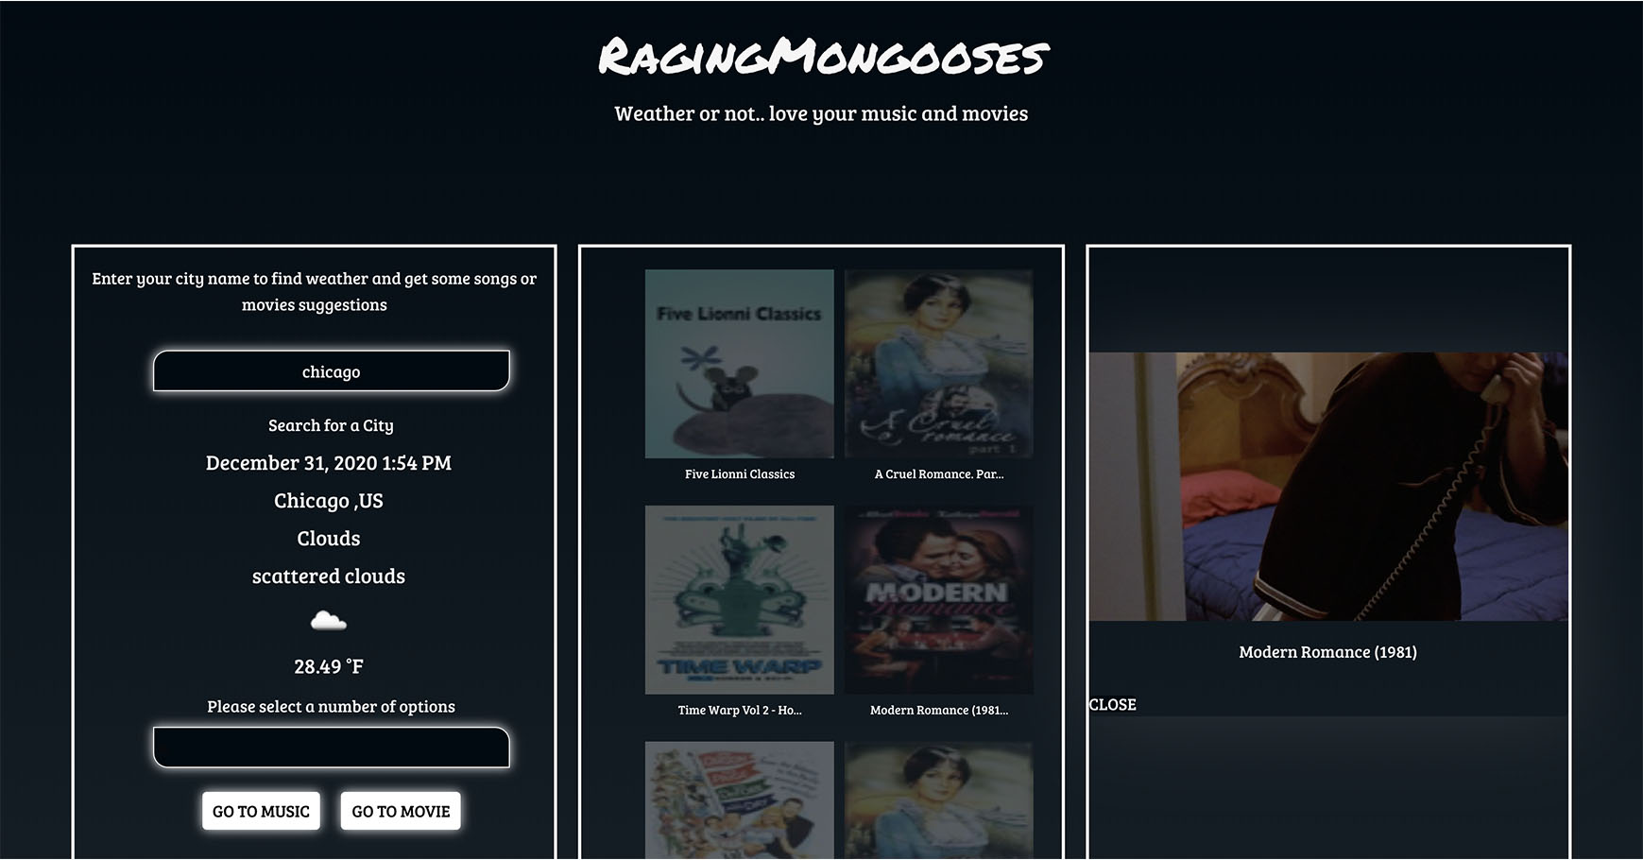
Actual APP view :
4.Video preview
Then click images
to view video.
Once the image is selected, it becomes blurred, and starts playing the video for related song or movie.
Once the user is finished, they can click on the "CLOSE" button to end the video.

Slide 11
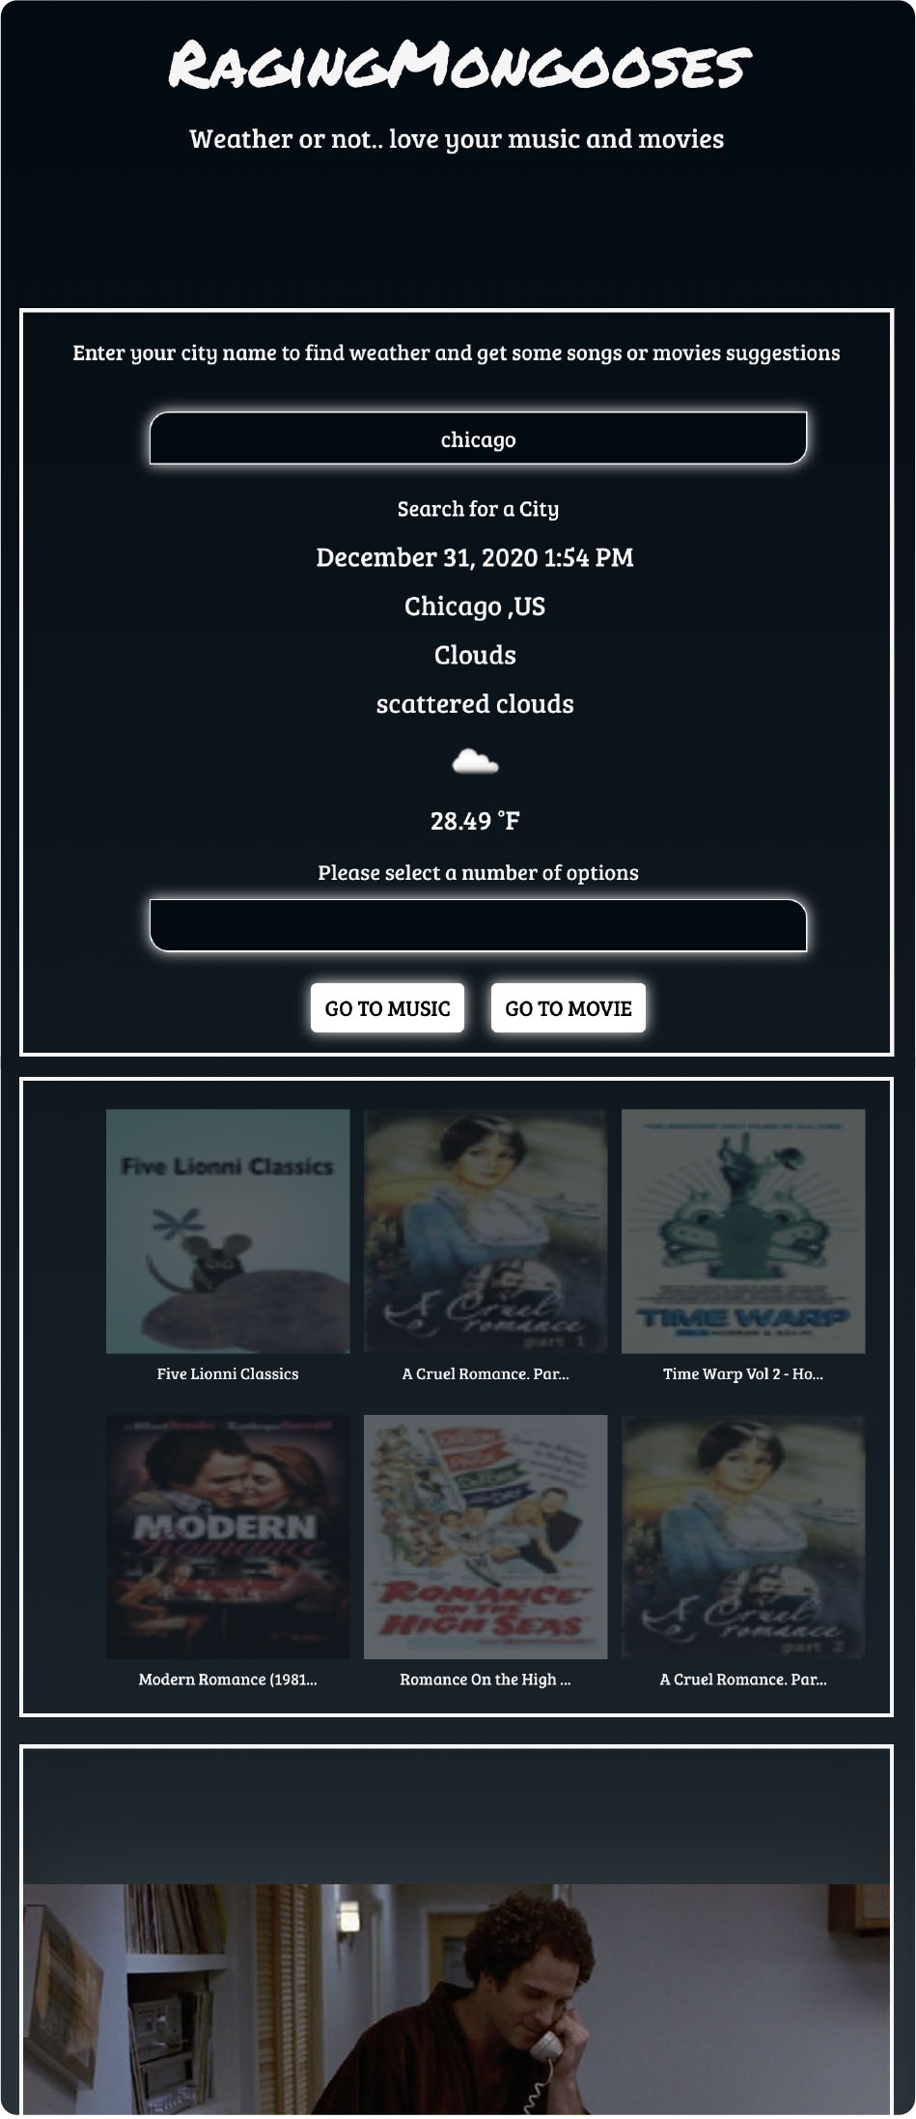
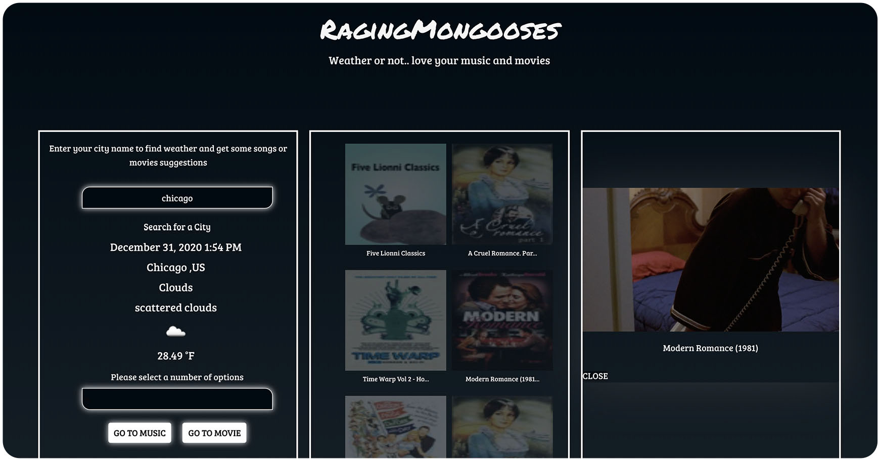
**Small screen APP**
Actual APP
view :
5.Responsive
view
**Full screen APP**

Slide 12
Future development:
2.Add more functions
On video section by adding
Progress bar , Toggleplay button etc .
Make video into full screen view
3. Adding more detailed info for
Video such as name/actors name etc
1.Provide more diverse search engine
Possibly add more info about the song or movie that the user selected.. With scroll bar with drop down menu •Music •Title •Artist •Genres of music •Year it was released •Movies •Title •Rating •Year released •Bio •Director •Writers •Main actors/actresses

Slide 13
Check this out on
Git hub page : https://oliviapark113.github.io/project7_group-1/
From Group#1
Michael, Kristina, Paul & Olivia…xoxoxo

